Slide 1
IMPLEMENTATION OF BINARY SEARCH USING 8085 MACHINE LANGUAGE
Shashank Saxena (RA2211003010147)
Raunak Naik (RA2211003010180)
Adya Singh (RA2211003010181)

Slide 2
INTRODUCTION
Binary search is the search technique that works efficiently on sorted lists. Hence, to search an element into some list using the binary search technique, we must ensure that the list is sorted.
Binary search follows the divide and conquer approach in which the list is divided into two halves, and the item is compared with the middle element of the list. If the match is found then, the location of the middle element is returned. Otherwise, we search into either of the halves depending upon the result produced through the match.

Slide 3
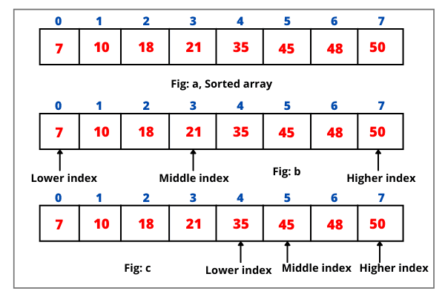
HOW DOES BINARY SEARCH WORK ?

Slide 4
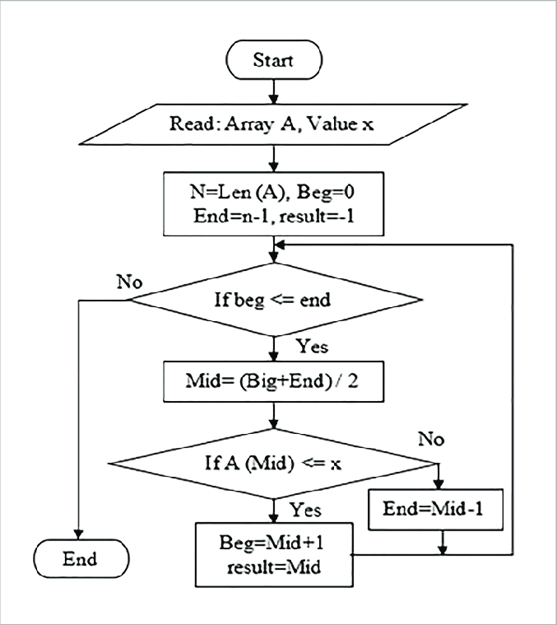
FLOWCHART

Slide 5
ALGORITHM
1. Move 0 to Accumulator and store it in 3003H, to indicate number of iterations so far.
2. Move 0 and 9 to L and H registers, respectively.
3. Load the data to search for in Accumulator from 3000H and shift it to B register.
4. Retrieve the number of iterations from 3003H, increase it by one and store back in 3003H.
5. Move value of H register to Accumulator and compare with L register.
6. If carry is generated, binary search is over so JUMP to step 20.
7. Add value of L register to Accumulator and right rotate it.
8. Store value of Accumulator in register C and force reset carry flag, if set.
9. Load the start address of the array in D-E register pair.
10. Add the value of accumulator to Register E and store the result in E.
11. Move 0 to Accumulator and use the ADC command to add any possible carry generated due to previous addition and store it back in Register D.

Slide 6
12. Load the value pointed to by D-E pair and compare with Register B. If carry is generated, JUMP to step 15(indicating the binary search is over) and if Zero flag is set, JUMP to step 17.
13. Move value of Register C to Accumulator and decrement Accumulator.
14. Move value of Accumulator to H and JUMP back to step 4.
15. Move value of Register C to Accumulator and increment Accumulator.
16. Move value of Accumulator to L and JUMP back to step 4.
17. Move 1 to Accumulator ad store in 3001H to indicate success.
18. Move value of Register C to Accumulator and store it in 3002H to save the index.
19. JUMP to statement 21 (the end of the program).
20. Move 2 to Accumulator and store it in 3001H to indicate failure.
21. End the program.

Slide 7
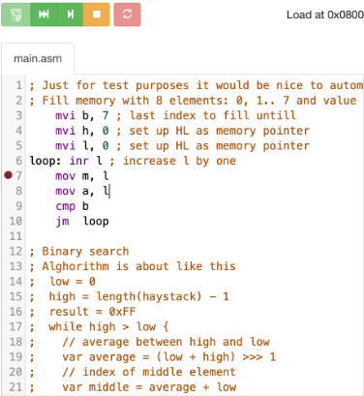
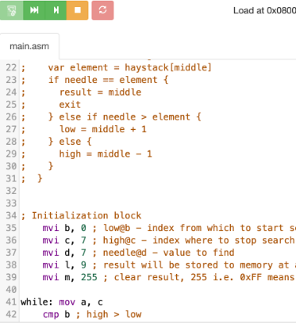
PROGRAM

Slide 8
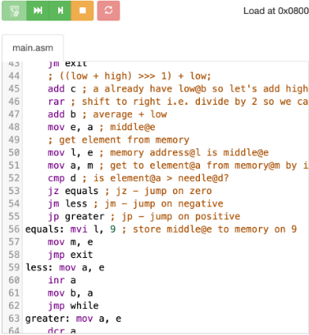
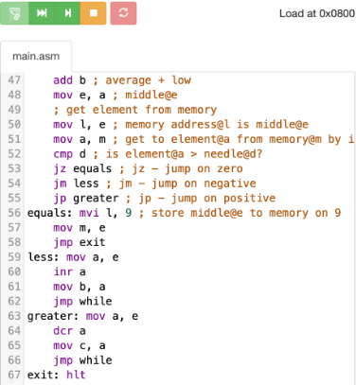

Slide 9
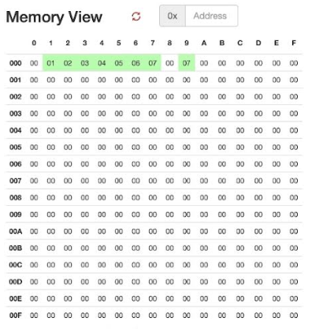
RESULT
Memory View: This typically represents the contents of the memory locations used by your 8085 program. It shows the values stored in memory addresses, often in hexadecimal format. This view helps you understand the current state of memory and can be useful for debugging and monitoring data stored in memory during program execution.

Slide 10
SUMMARY
Here is a concise summary of the program's functionality:
1. Initialization: The code initializes an array (haystack) with values from 0 to 7, stored in memory locations 0 to 7.
2. Binary Search: It performs a binary search for a specific value (the "needle"), which is set to 7 in this case.
3. Result Storage: The result of the binary search, which can be the index of the found needle or 0xFF (indicating not found), is stored in memory location 9.
4. Binary Search Logic: The binary search is implemented with a loop that continues until the high index is no longer greater than the low index. In each iteration, the middle index is calculated, and the element at the middle index is compared to the needle. Based on this comparison, the low and high indices are adjusted to narrow down the search range.

Slide 11
CONCLUSION
The conclusion is that the code successfully implements a binary search algorithm in 8085 assembly language. The final result, which is the index of the needle (if found) or 0xFF (not found), will be stored in memory location 9. The actual value of memory location 9 depends on the position of the needle in the haystack. If the needle is present in the haystack, the value stored in memory location 9 will be the index of the needle. If the needle is not present in the haystack, the value will remain 0xFF. The specific output will vary based on the actual contents of the haystack and the needle being searched for.

